Slide 1
The Battle of Neighbourhoods
Coursera Capstone Project

Slide 2
Introduction
This project leverages the techniques and tools learnt in the Data Science courses to analyse a practical problem in regards to picking location
Python data analysis
Data visualization in graphs and maps
Foursquare API
Machine learning technique, specifically K-means clustering

Slide 3
Business problem and Audience
I am a tourist in London, planning my one-day activity: a park in the morning, a museum or art gallery to follow, a Japanese restaurant for meal and a musical/live performance in a theatre to end
Which tube stations in Zone 1 should I go with all these four types of venues nearby?
The analysis is aimed to be adaptable for trip planning by any tourist with customised choice of city and personalised interests.

Slide 4
Data
List of London tube stations in Zone 1 (https://en.wikipedia.org/wiki/List_of_stations_in_London_fare_zone_1)
Borough-level statistics of tourism trips by foreign and domestic tourists (https://data.gov.uk/dataset/ee5038be-d2be-4ab6-a612-70ade60eca12/tourism-trips-borough)
Annual entries and exits by passengers of a station (https://data.london.gov.uk/download/london-underground-performance-reports/b6ab04fc-9062-4291-b514-7fa218073b4c/multi-year-station-entry-and-exit-figures.xls)
Geo codes of tube stations (https://www.doogal.co.uk/LondonStationsCSV.ashx)

Slide 5
Data Preparation
Selection criteria out of the Zone-1 tube stations (84 in total):
in the top 5 boroughs with the most foreign and domestic tourism trips: Westminster, Kensington & Chelsea, Camden, City of London and Tower Hamlets
managed by London Underground
annual entries and exits by passengers >= 5 million
Technique used in data processing:
Web scrapping by BeautifulSoup
Pandas data frame methods (read excel, drop, merge, replace etc.)
49 candidate tube stations in Zone-1 selected, together with their geo codes.

Slide 6
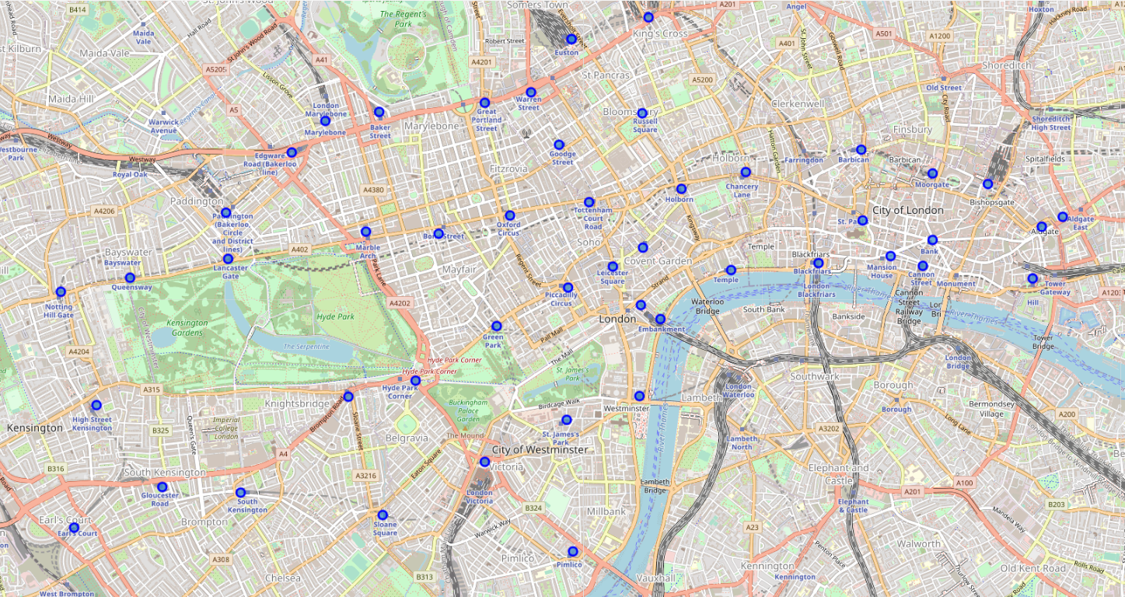
Candidate stations on map

Slide 7
Methodology for Data Analysis
Foursquare: to obtain nearby venues around each select station and get venue categories
Categories selected: Park, Art Gallery, Art Museum, History Museum, Japanese Restaurant, Opera House and Theater
Pandas data analysis
Onehot dummy variables
K-means clustering
Determine the best number of clusters by Elbow Method (the best K = 5)

Slide 8
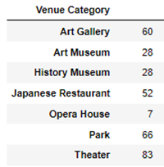
Results (i) – 324 venues, 11 stations and 4 clusters
There are 324 venues of selected categories in total surrounding the 49 candidate tube stations
Only stations with at least one venue for each category (i.e. park, art/museum, food and performance) nearby are kept, and stations that lack venues of any one category are removed
11 stations are shortlisted, are grouped into 4 clusters
Not any station in cluster 4 is in the list, since not venues of all categories are available around.

Slide 9
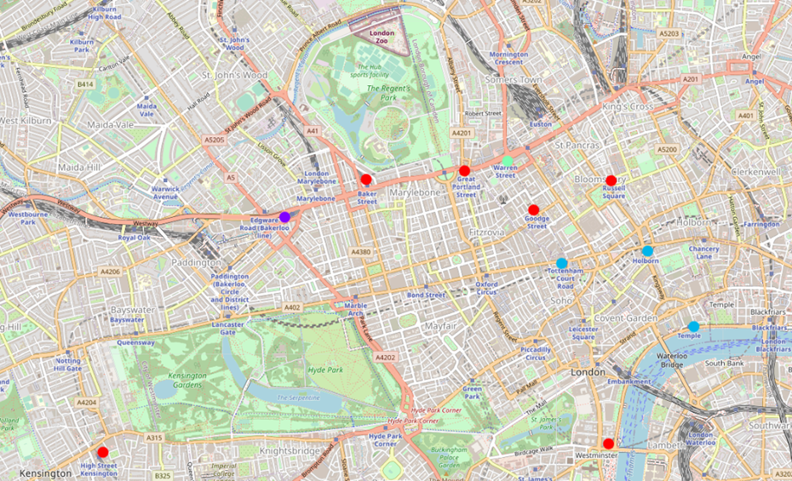
Results (ii) – visualize clusters on map
Red: Cluster 0 (6 stations)
- Baker Street
- Goodge Street
- Great Portland Street
- High Street Kensington
- Russel Square
- Westminster
Purple: Cluster 1 (1 station)
- Edgware Road
Blue: Cluster 2 (3 stations)
- Holborn
- Temple
- Tottenham Court Road
Green: Cluster 3 (1 station)
- Warren Street

Slide 10
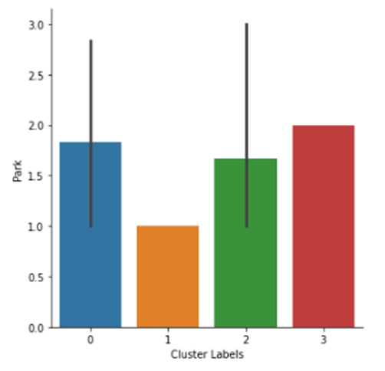
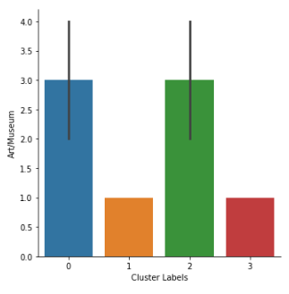
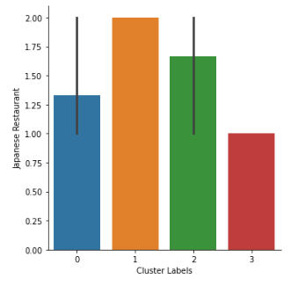
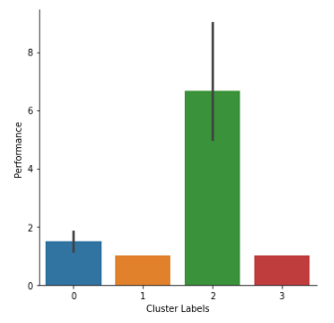
Results (iii) – cluster comparison
Mean description of clusters and average number of venues by category
Observations
While Cluster 0 has the most stations (6), Cluster 2 has the most number of venues (13) around each station on average.
Cluster 3, 0/2, 1 and 2 are the best in Park, Art & Museum, Japanese Restaurant and Theater category respectively.
Clusters 1 and 3 are not bad in terms of food and green spaces, but lag in Art & Museum and Theater.
Cluster 0 is similar to Cluster 2 in Park, Art/Museum and Restaurant categories, but weaker in the Theater category.
As a whole, Cluster 2 appears to be the better choice, with balanced ranking in all categories. In addition, as seen from the map, stations in Cluster 2 (light blue circles) are close to each other, and thus flexible to pass from one to the other.
Park
Art & Museum
Restaurant
Theatre & Opera House

Slide 11
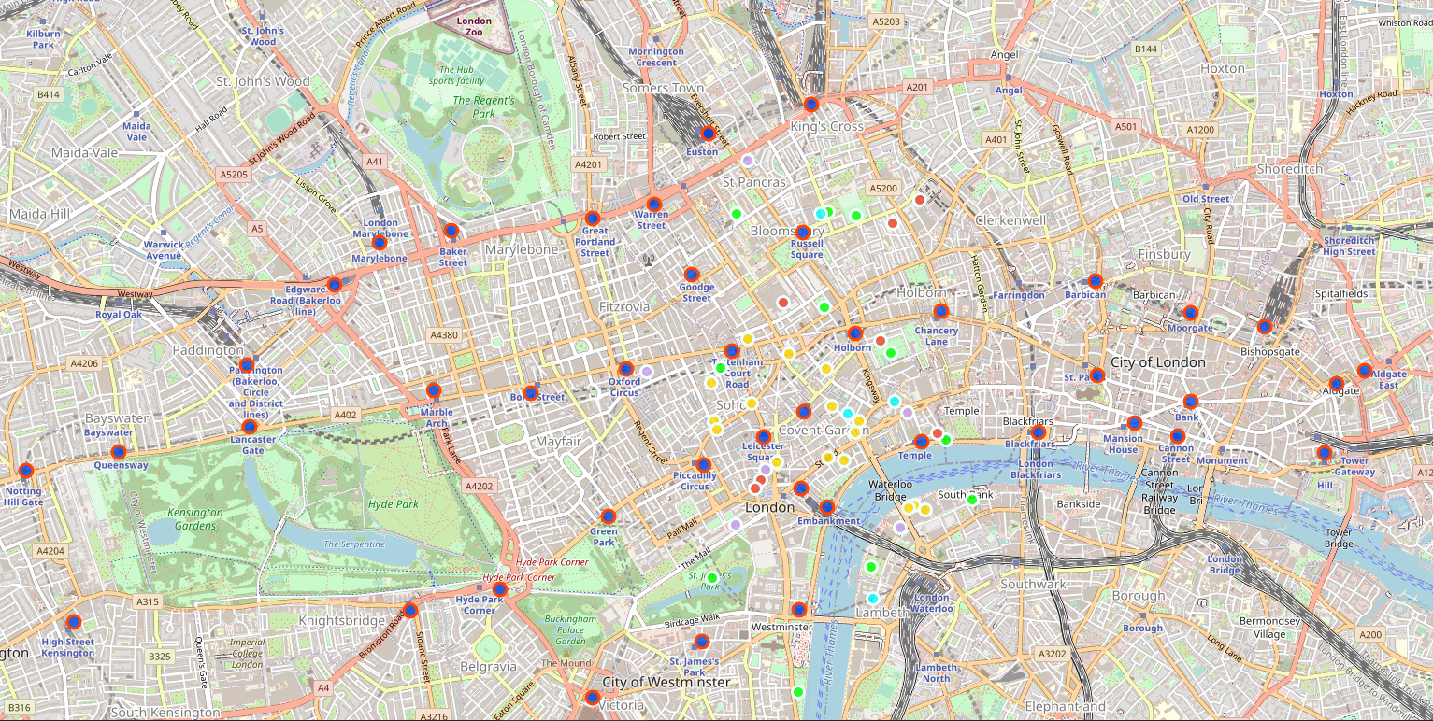
Results (iv) – top 5 stations and venues nearby on map
The top 5 stations are Temple, Russell Square, Holborn, Tottenham Court Road and Westminster, ranked by the total number of venues nearby.
Park: light green
Museum: red
Art gallery: lavender
Japanese restaurant: light blue
Theatre and Opera House: yellow

Slide 12
Conclusions
This project leverages key techniques and tools learnt in the series of Data Science courses (e.g. Foursquare API and K-Means clustering) to facilitate individuals’ trip planning.
Specifically, the problem to solve is to pick out Zone-1 tube stations in London that has parks, museums/art galleries, Japanese restaurants and theaters around.
The analysis is expected to be easily adaptable to any customised choice of city and venue categories of interest.
For future enhancement, attributes related to price and popularity (e.g. count of likes and ratings) of venues from Foursquare could be added in the analysis for more comprehensive assessment.

